Slide 1
ONAP - Overview

Slide 2
Issues
A major roadblock many organizations face in the drive for efficiency is that their network is far more difficult to manage than ever before.
Distributed workloads and distributed IT resources have led to extremely complex configurations and poor visibility across the network.
Much of the management work on these networks has traditionally been performed manually, via command-line entry. That’s proved to be tedious, costly, unnecessarily rigid, and prone to error.
Complex, hard-to-manage networks are hindering business innovation, making critical security improvements more difficult, and driving up costs. These set of drawbacks has naturally led to a search for better approaches.
Increased Capex and Opex
Huge manual efforts involved

Slide 3
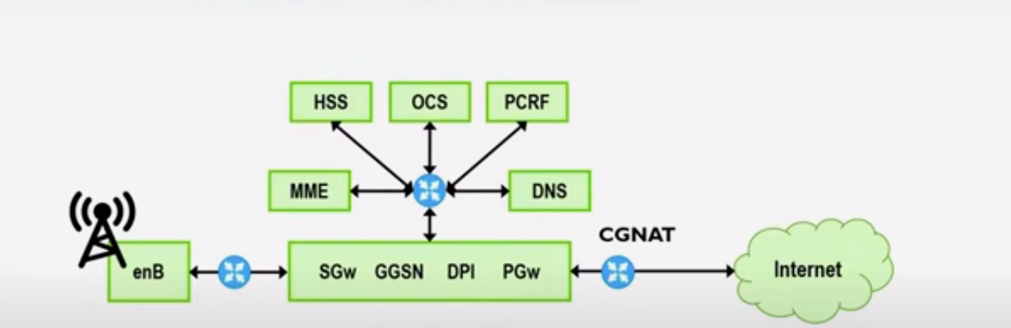
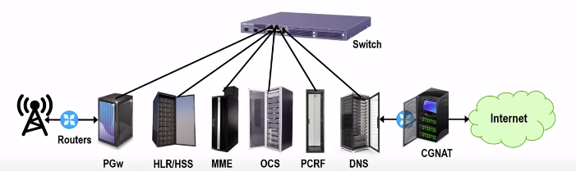
Traditional LTE Network
What are the problems ?
Lack of scalability
Lack of speed and lack of flexibility.
This hampers the business as there is always delay in new product launch and meeting customer requirements/expectations.
Possible way out:
SDN
NFV
Automation
Orchestration
Individual hardware racks, serving individual function
Specialized Devices/Purpose Build: Specialized hardware meant to perform very very specific function

Slide 4
NFV: Network function virtualization
The NFV architecture defines how software functions can be executed in virtual machines (VMs) and consolidated to share common physical resources in terms of compute, storage, and networking.
Multiple functions can be instantiated within the same VM using containers. VMs can be dynamically instantiated to cope with changing network demand in terms of traffic and in terms of offered features and services
Softwarization
Orchestration
Virtualization
NFV is all about 3 main components
Softwarization
Virtualization and
Orchestration
NFV replaces costly dedicated and purpose build hardware with generic servers that use software to provide a bunch of different virtualized network functions (VNFs)

Slide 5
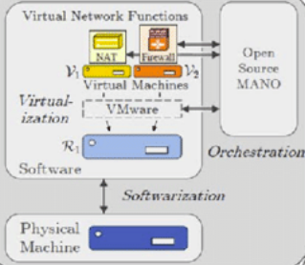
NFV: Network function virtualization
NFV is all about 3 main components
Softwarization ------>
Virtualization and
Orchestration
Softwarization refers to the paradigm where a given functionality runs in software instead of hardware. This approach guarantees high degree of flexibility and reconfigurability as functionalities can be enhanced (or novel functions introduced) by updating the software.
As softwarization breaks the relationship between functions and the underlying hardware, it has obvious benefits in terms of time to deploy, CAPEX and OPEX reduction when updating or introducing new functions.

Slide 6
NFV: Network function virtualization
NFV is all about 3 main components
Softwarization
Virtualization ------>
Orchestration
Virtualization enhances the software/hardware splitting of the softwarization paradigm by creating abstracted (i.e., virtual) instances of hardware platforms, operating systems, storage devices, and computer network resources.
This means that, with virtualization, software runs in commercial off-the-shelf (COTS) equipment (e.g., standard server) by exploiting a virtual machine (VM) instead of a dedicated hardware.
As VMs can be moved across different hardware platforms, virtualization introduces flexibility by means of flexible VM placement and migration. Other benefits are in terms of reduced CAPEX and OPEX, as the introduction of new services requires the introduction of new VMs without requiring any effort from a hardware point of view.

Slide 7
NFV: Network function virtualization
NFV is all about 3 main components
Softwarization
Virtualization
Orchestration ------>
Orchestration is the execution of the operational and functional processes involved in creating and delivering an end-to-end service.
Traditionally, these processes were handled by domain-specific, siloed operational support systems and tools built for static environments.

Slide 8
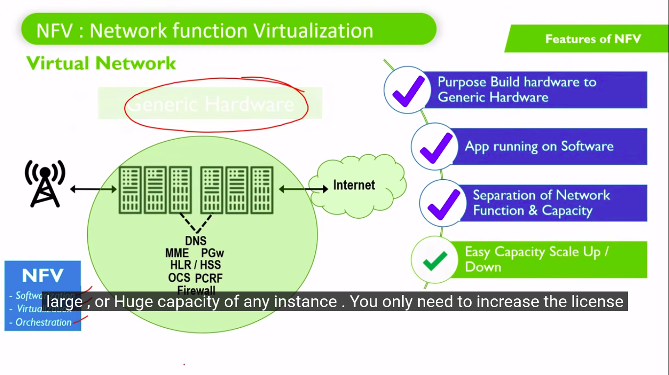
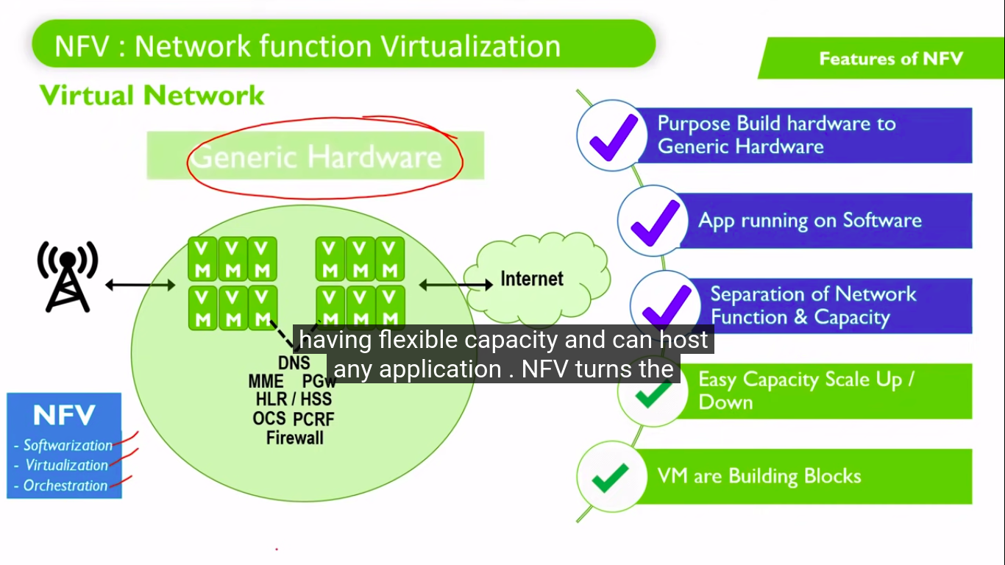
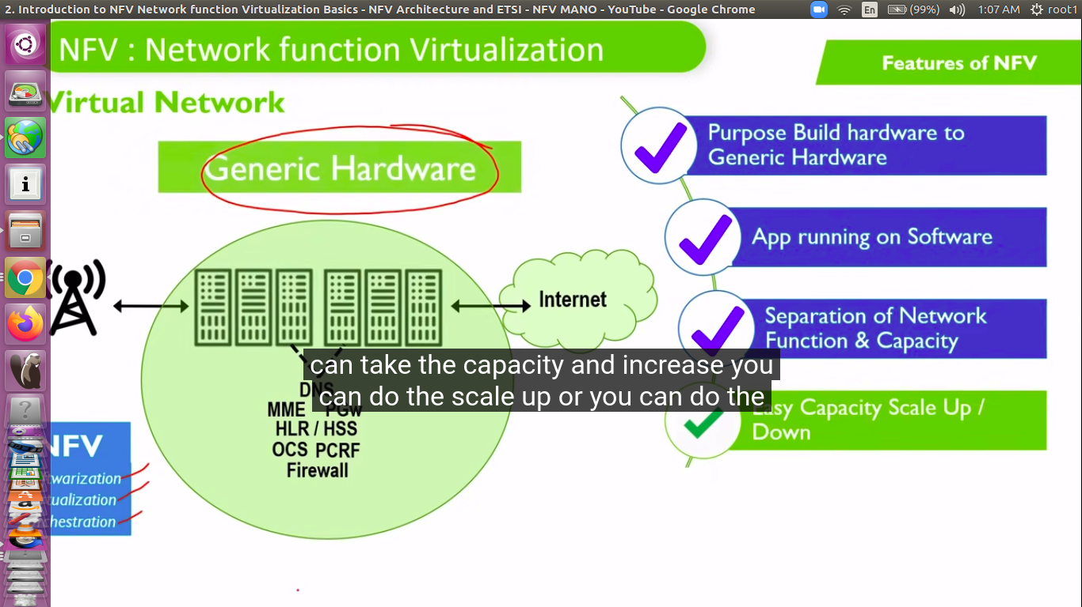
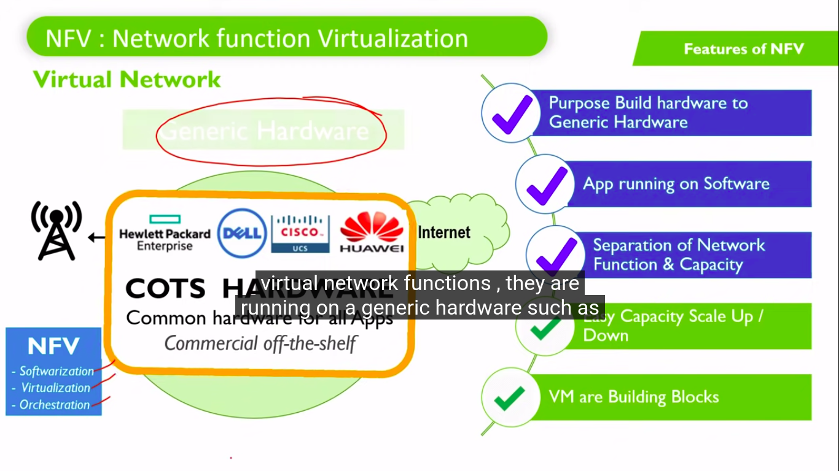
NFV: Network function virtualization

Slide 9
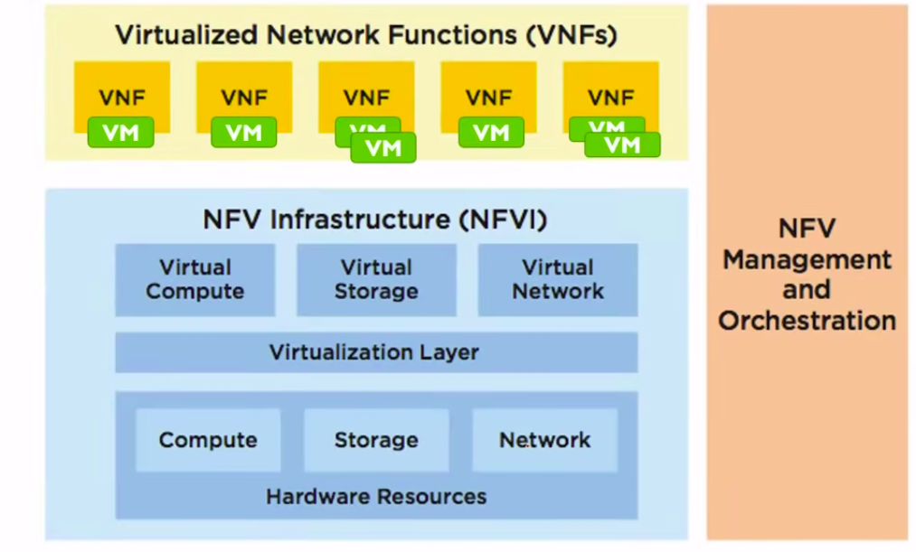
NFV Architecture
Building blocks of NFV
Network functions virtualization infrastructure (NFVI) is the layer who is responsible to handle hardware , This hosts all Storage , Compute & Network hardware & abstract same as virtual resources for consumption of virtual machines .
Virtualized network functions (VNFs) is layer where we host actual Application working network functions running as Software . One single VNF can be deployed over multiple virtual machines
On the right hand side , You can see NFV-MANO Layer which is Network functions virtualization management and orchestration architectural framework Managing & Controlling the entire piece

Slide 10
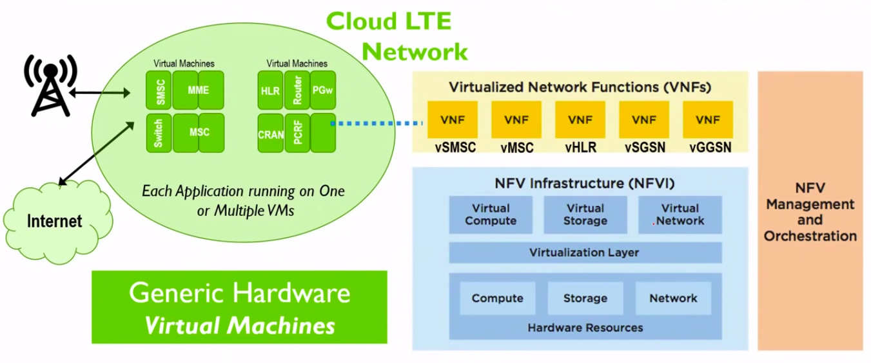
NFV: Network function virtualization
This shows the applications as vSMSC , vMSC , vHLR , vSGSN or vGGSN are deployed as Software module.
We can allocate resources to these Virtual Nodes on basis of requirement such as vHLR(home registry location) needs more storage while vMSC(mobile switching centre) requires more Compute.
All of these Individual virtual network nodes can have reserved Compute , Storage & Network which will be used by that application Only .
For Example , You can allocate 5 vCPUs , 8 TB & 2 NIC to virtual SMSC as application . SMSC will not eat up resources allocated to MSC or HLR . This allocation of resources is done by Virtualization layer sitting in NFVI layer

Slide 11
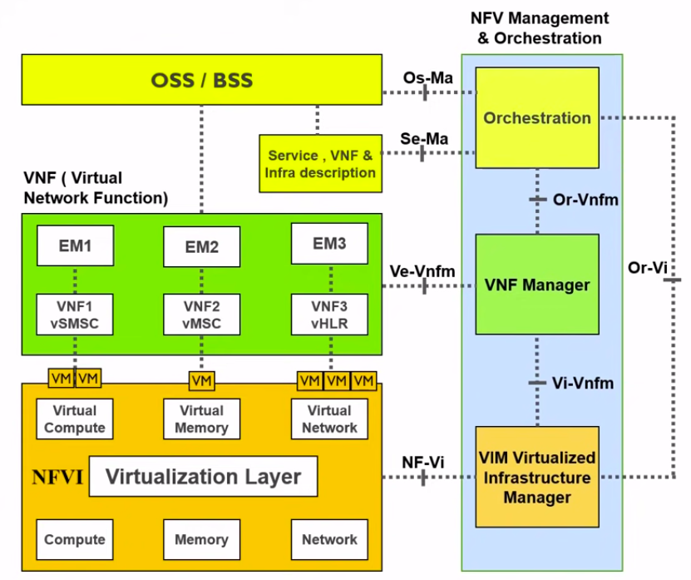
NFV Layers & Architecture
NFV Orchestrator (NFVO)
Key to Automation of SDN & NFV.
Perform :
Resource orchestration
Network service Orchestration
Global resource management of NFVI resources via VNFM and VIM.
Allocation and scaling resource.
Single Orchestrator for NFV service.
EM:The FCAPS and O&M of Applications such as vMSC or vSMSC or vHLR is done by EM shown on top of VNF . The EM stands for Element Management and does FCAPS of Application such as MSC Link down , MSC KPI Degradation etc.
VNFM: Virtual Network Function Manager
Lifecycle of VNFs:
Setting UP
Maintaining
TearDown
FCAPS of virtualization and VNF
VNF: Basic building block of NFV architecture.
VIM: Virtualized Infrastructure Manager
Manage and control NFVI
Also manages Reports & Events
NFVI: Network function Virtualization Infrastructure
Manage physical part of NFVI
Hypervisor: responsible for abstracting physical resource into virtual resources.

Slide 12


SDN
Virtual Compute
Network Reachability
NFV
?
For any new Node or New Service , we need multiple things such as
IP Allocation
Policy Opening
Routing Changes
Bandwidth Allocation
End to End Reachability
Service Testing
Few Seconds
All this is not automated & it takes lot of time to prepare design , perform changes in every router / switch & make it thru
Well , We have seen NFV helps in Virtualizing networks which help us in rapid deployment & ultimately reduces New Service / New Node Creation time to few seconds . For example , We can create vMSC or vMME in few seconds & make it ready with help of Orchestrator & Automation. But the another problem is Network connectivity .
In typical scenarios , This make take few days or week to finish IP Routing & enabling end to end reachability of all required links .
SDN helps us here by making this routing / switching network flexible & programmable

Slide 13
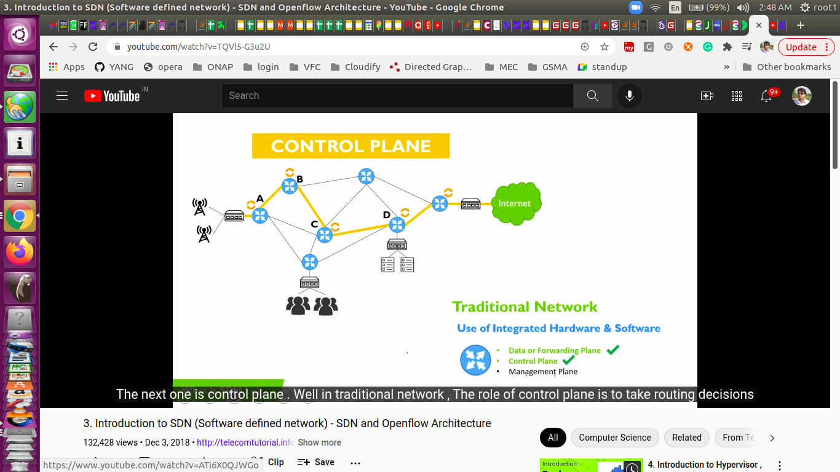
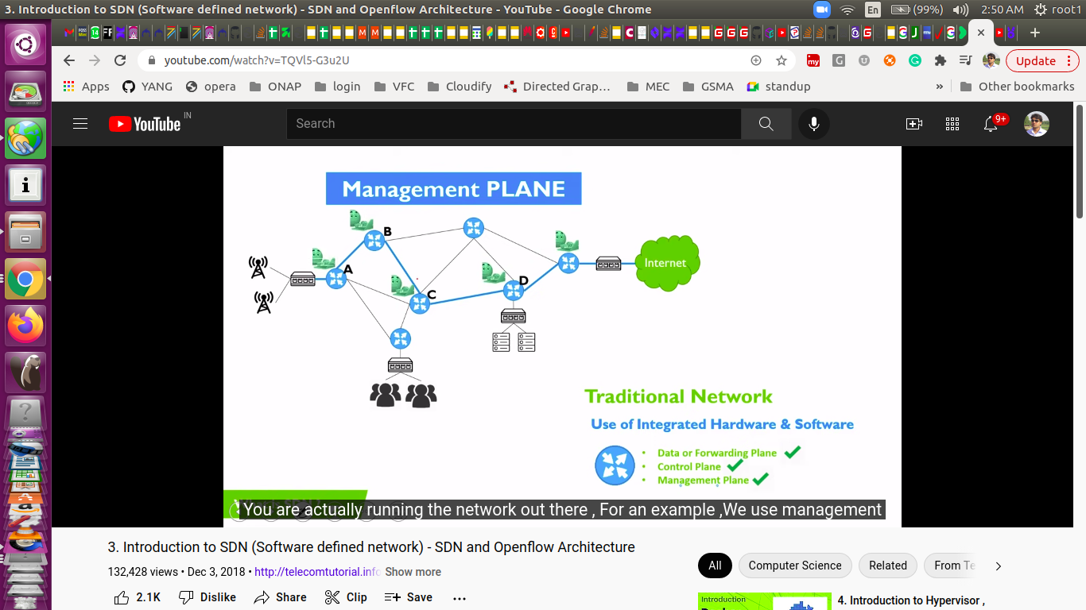
Traditional Network
In traditional network , The role of control plane to take routing decisions . Every router is having its own brain to decide best path to route the traffic . These routing decisions are taken on basis of routes configured in router and routes learned from adjacent routers
In traditional network , mgmt plane is used for performing Operation & maintenance of network . For example , We use Management plane to fetch reports , Perform Configurations , Get Alerts and Alarms
If you have to Open new route , Eventually we need to login into every router and this is quite tedious task which takes lot of time & prone to errors due to manual configuration involved

Slide 14
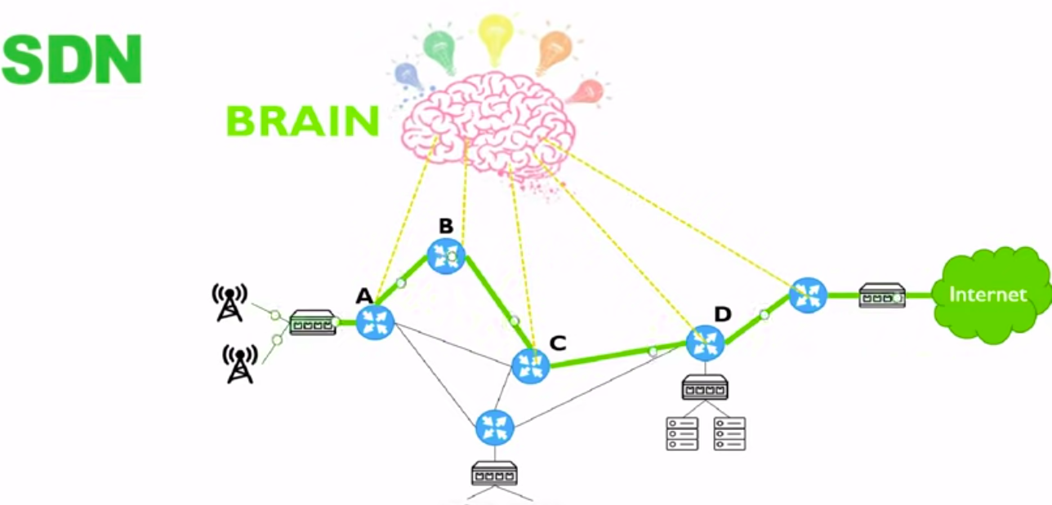
SDN - Software Defined Networking

Slide 15
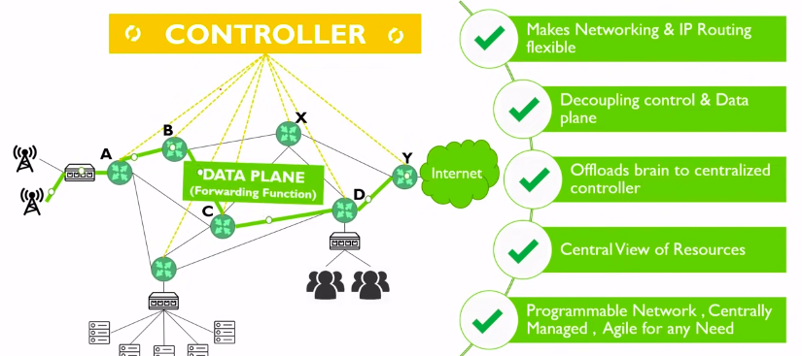
SDN

Slide 16
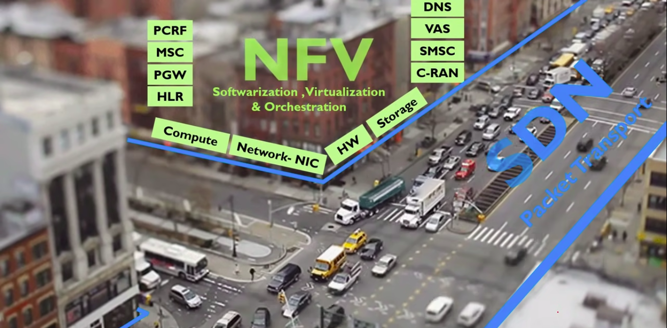
SDN & NFV

Slide 17
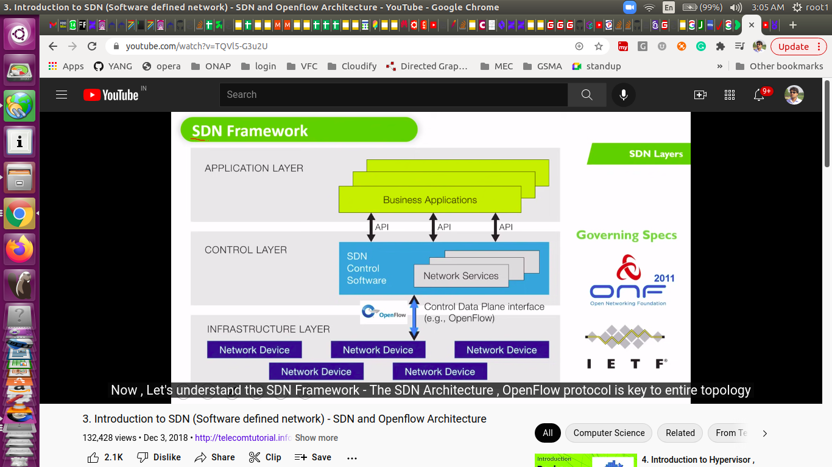
SDN Architecture

Slide 18
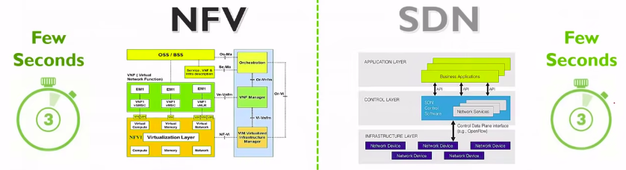
NFV & SDN
Virtual Compute
Network Reachability

Slide 19
Orchestration
Orchestration is the execution of the operational and functional processes involved in creating and delivering an end-to-end service.
Network orchestration is network automation across multiple types of infrastructure devices, network domains, and even multi-vendor systems in a network. More specifically, orchestration can be policy-based or event-driven automation through programmatic interfaces like RESTful APIs enabled by third party software or within a single integrated end to end network infrastructure solution.
Automation vs Orchestration
• Automation is a way to eliminate the manual effort/human intervention involved in activities and bring in an ability to perform the same repeatedly, consistently and with better efficiency.
• Orchestration is executing the automation/manual ability of various modules in harmony as a consolidated process or workflow to accomplish the desired tasks.
Example : Managing lifecyle of a E2E service

Slide 20
Orchestration vs Automation
Network orchestration is a more advanced level of network automation. You can think of network automation handling low-level single tasks, whereas network orchestration manages high-level sequences of inter-dependent tasks across multiple systems.
Network automation is often somewhat linear. Since orchestration is more network-aware, it executes workflows based on device states and configurations.
Network orchestration use cases
Network orchestration can offer many benefits, including:
Ensuring QoS policies are being followed
Automating troubleshooting
Auto configuration of new devices
Establishing overlays for the control plane and the forwarding plane
Provisioning network services
Providing workflow automations

Slide 21
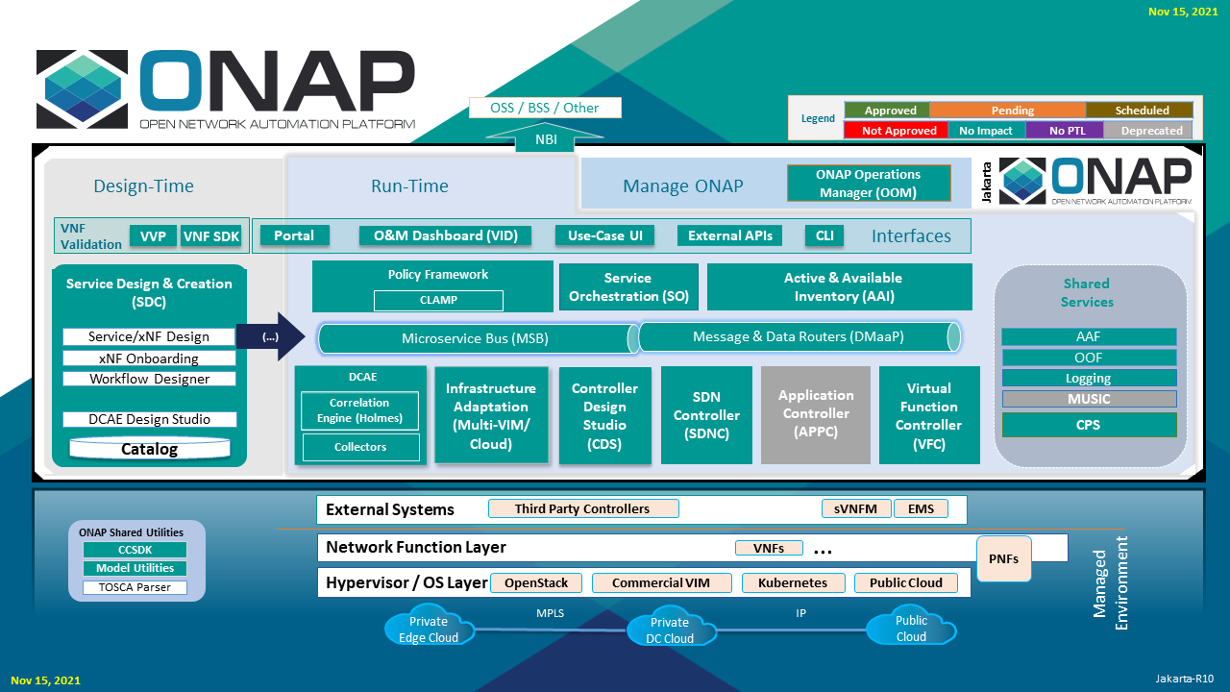
ONAP Architecture
The ONAP architecture consists of a design time and run time functions, as well as functions for managing ONAP itself.

Slide 22
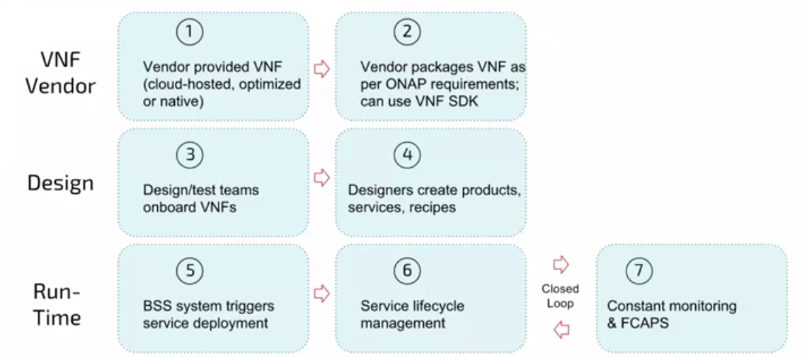
A Day in the Life of ONAP

Slide 23
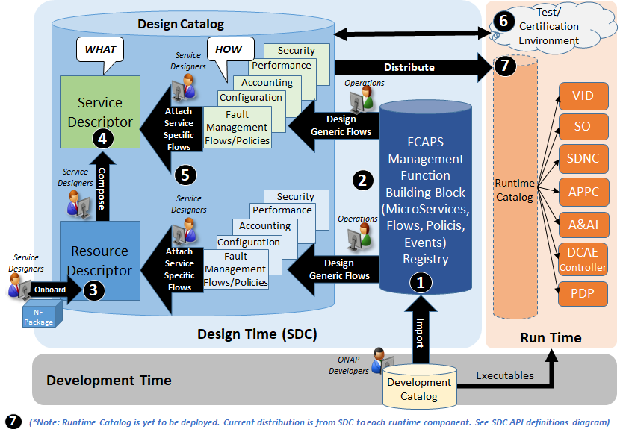
DesignTime component - SDC
SDC is the Centralized ONAP Design Time Platform
SDC Provides Service Provider a seamless design time user experience
Allow SP to configure for its design environment including user roles and design workflows
Import generic ONAP management functions (MS, Flows, Policies) from ONAP developed software and SP’s adaptations (1) (2)
Onboard & Design resource level network functions (VNF, PNF) (3)
Compose Service models with resources (4)
Design Service Provider specific Management Flows and Policies for the Resource or Service Model (5)
SDC integrates multi design tools into one platform
Provide ONAP development a “Pluggable framework” for easy design tools integration
SDC Provides a common Catalog for designed objects
Support robust catalog cataloging capabilities for storage and management of ONAP standard compliant data models
Provide linkage & management of SP’s Test/validation process & artifacts for certification of the designed models (6)
Distributes models to runtime for execution (7)
Note: in addition, ETSI compliant models/packages will be distributed to the Modeling etsicatalog (ETSI Catalog Manager)

Slide 24
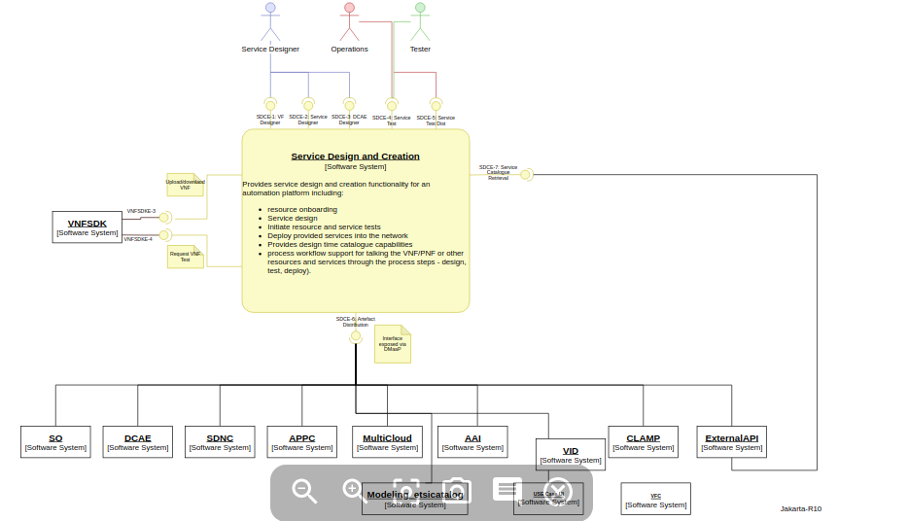
DesignTime component - SDC

Slide 25
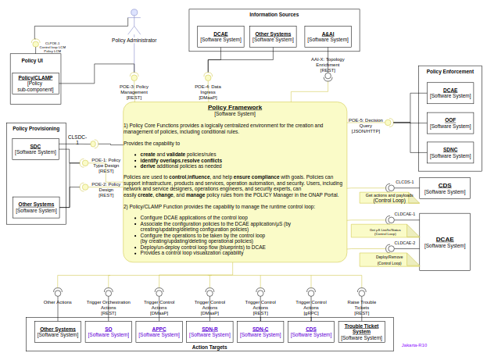
DesignTime component - Policy
Policy Framework and SDC are the key ONAP design time components
• Policy Framework
• Provides a logically centralized environment for the creation and management of modifiable configurations, rules, assertions and/or conditions to provide real-time decision making on conditions and events that underlie ONAP’s control, orchestration, and management functions
• Supports specification, decomposition, distribution and enforcement for various types of policies such as microservice configuration policy, operational policy, decision policy, guard policy, etc.
• Policy scopes include, but are not limited to, infrastructure/network management, products and services, operation automation, and security.

Slide 26
DesignTime component - Policy
Provides the capability to
create and validate policies/rules
identify overlaps,resolve conflicts
derive additional policies as needed
Policies are used to control,influence, and help ensure compliance with goals. Policies can support infrastructure, products and services, operation automation, and security. Users, including network and service designers, operations engineers, and security experts, can easily create, change, and manage policy rules from the POLICY Manager in the ONAP Portal.
2) Policy/CLAMP Function provides the capability to manage the runtime control loop:
Configure DCAE applications of the control loop
Associate the configuration policies to the DCAE application/µS (by creating/updating/deleting configuration policies)
Configure the operations to be taken by the control loop (by creating/updating/deleting operational policies)
Deploy/un-deploy control loop flow (blueprints) to DCAE
Provides a control loop visualization capability

Slide 27
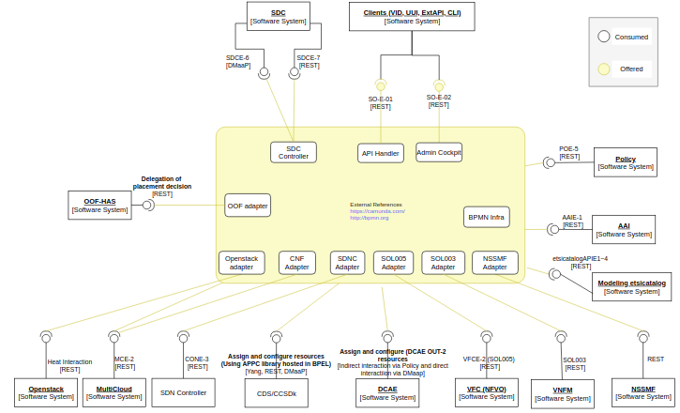
RunTime Component - SO
The Service Orchestration (SO) component is in charge of orchestration of network services and resources.
Technologically it is based on the use of BPMN.
BPMN is a standard, defined by the OMG (Object Management Group) to document Workflows. SO uses the Camunda BPMN engine to run BPMN workflows
ONAP comes with a large collection of BPMN workflows. These Workflows can be divided into main processes and sub-processes BPMN workflows.
A BPMN workflow is a description, mainly composed of "Tasks". Each task in a workflow is linked to a piece of code (Groovy or Java) that implement the Task.

Slide 28
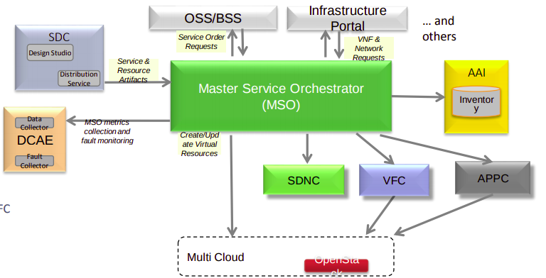
RunTime Component - Service Orchestrator
The Service Orchestrator (SO) component of ONAP provides orchestration at a very high level, with an end to end view of the infrastructure, network, and applications.
SO Key Interactions with ONAP components
SDC
Distribution of orchestration artifacts (service & resource recipes and templates)
UEB event notifications, HTTP artifact retrieval
AAI
Query and update inventory
RESTful API
Cloud (Platform Orchestrator)
Instantiation of virtual resources in the cloud
Openstack APIs (primarily Heat and Keystone)
SDN Controller
Assign and configure network resources
Yang-based RPC and REST
VFC Controller
Able to delegate the Network service details to VFC Rest Based interaction over MSB
Policy
Able to execute the policy recipe for a given policy ID

Slide 29
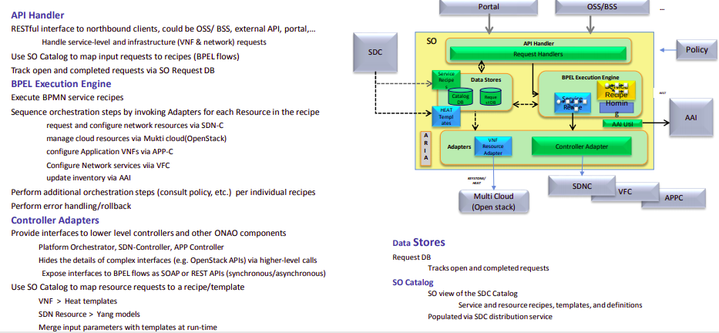
RunTime Component - Service Orchestrator Arch

Slide 30
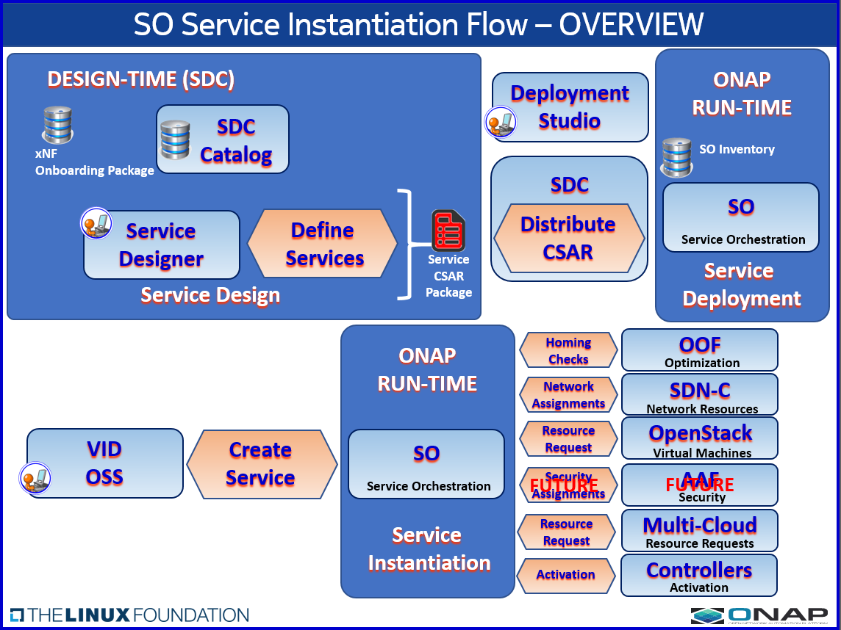
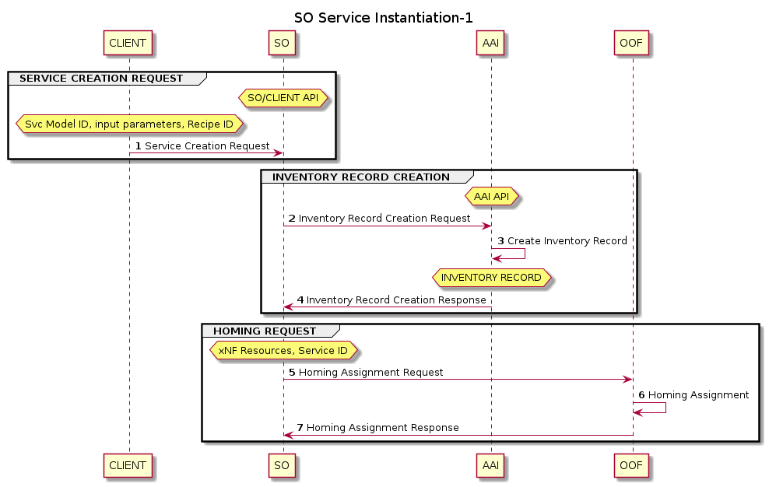
Service Instantiation Flow

Slide 31
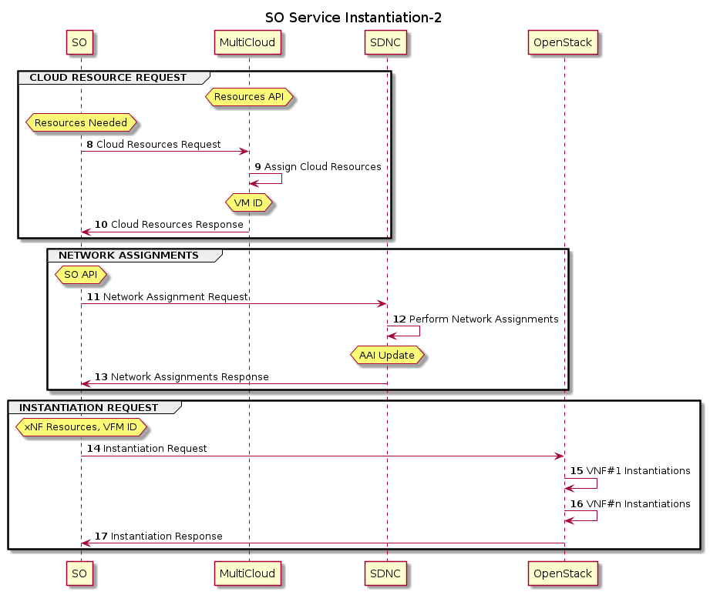
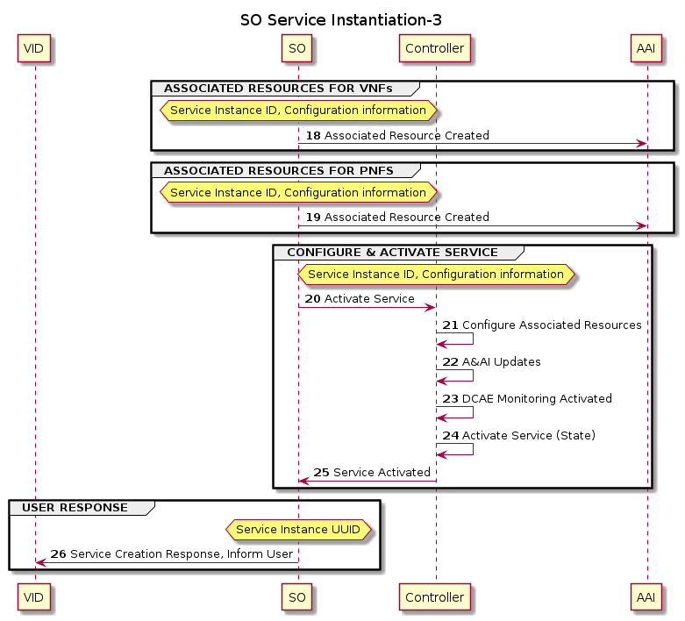
Service Instantiation Flow

Slide 32
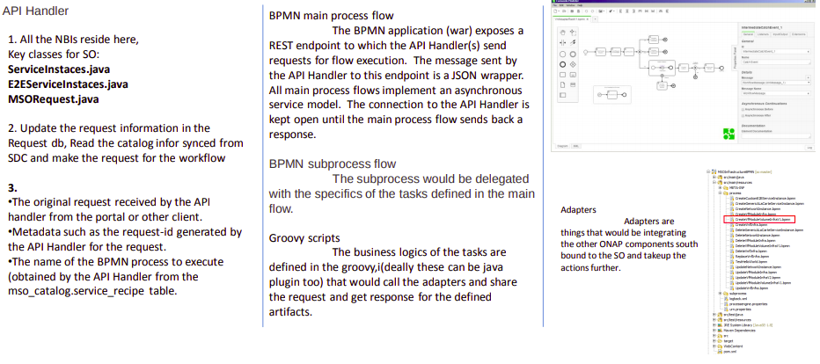
How to SO

Slide 33
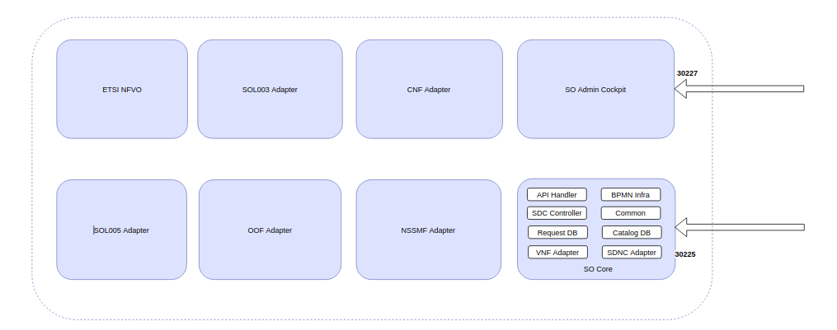
RunTime Component - ONAP SO key Component view

Slide 34
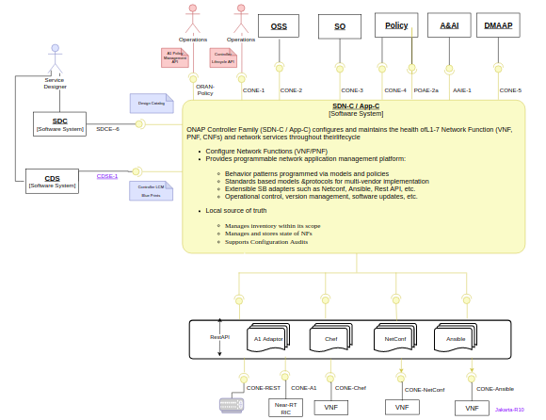
RunTime Component - SDNC
ONAP Controller (SDN-C) configures and maintains the health ofL1-7 Network Function (VNF, PNF, CNFs) and network services throughout theirlifecycle
Configure Network Functions (VNF/PNF)
Provides programmable network application management platform:
Behavior patterns programmed via models and policies
Standards based models &protocols for multi-vendor implementation
Extensible SB adapters such as Netconf, Ansible, Rest API, etc.
Operational control, version management, software updates, etc.
Local source of truth
Manages inventory within its scope
Manages and stores state of NFs
Supports Configuration Audits

Slide 35
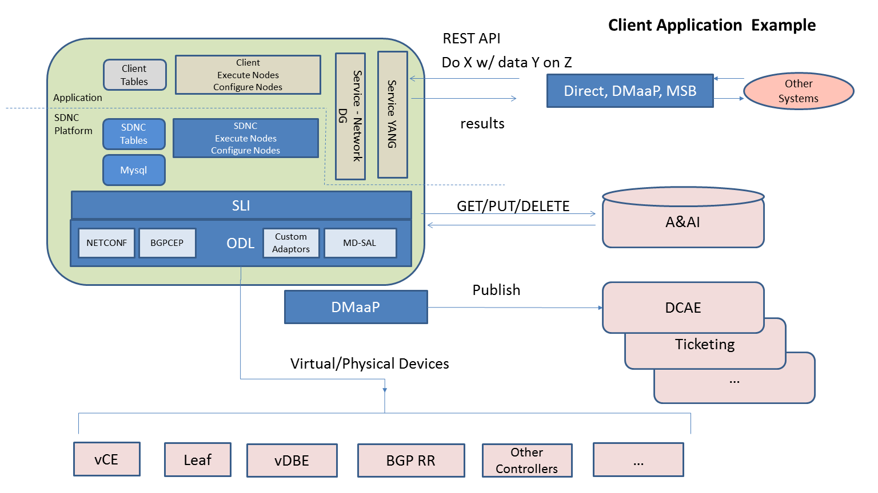
RunTime Component - SDNC
SDNC: Leverages OpenDaylight
Model driven service abstraction layer:
• API handlers,
• Operational and configuration trees,
• An adapter framework for integrating with controlled devices, virtual functions, and cloud infrastructure.
• Within this framework the ONAP Service Logic Interpreter (SLI) addition provides an extensible scripting language for expressing service logic through a Directed Graph (DG) builder based on Node-Red. The SLI is extended by adding Java classes that can be called as a node in a DG to support frequent complex operations
• Based on OpenDaylight Controller framework

Slide 36
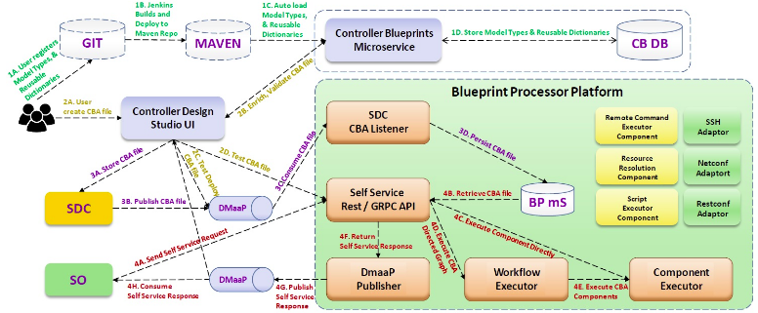
Controller Design Studio - CDS
CDS is a framework to automate the resolution of resources for instantiation and any config provisioning operation, such as day0, day1 or day2 configuration.
CDS has a both design time and run time activities; during design time, Designer can define what actions are required for a given service, along with anything comprising the action. The design produce a CBA Package . Its content is driven from a catalog of reusable data dictionary and component, delivering a reusable and simplified self service experience.
CDS modelling is mainly based on TOSCA standard, using JSON as reprensentation.
{
"tags" : "oam-local-ipv4-address",
"name" : "create_netbox_ip",
"property" : {
"description" : "netbox ip",
"type" : "dt-netbox-ip"
},
"updated-by" : "adetalhouet",
"sources" : {
"config-data" : {
"type" : "source-rest",
"properties" : {
"type" : "JSON",
"verb" : "POST",
"endpoint-selector" : "ipam-1",
"url-path" : "/api/ipam/prefixes/$prefixId/available-ips/",
"path" : "",
"input-key-mapping" : {
"prefixId" : "prefix-id"
},
"output-key-mapping" : {
"address" : "address",
"id" : "id"
},
"key-dependencies" : [ "prefix-id" ]
}
}
}
}
https://github.com/onap/ccsdk-cds/tree/master/components/model-catalog/blueprint-model/test-blueprint/golden/Definitions

Slide 37
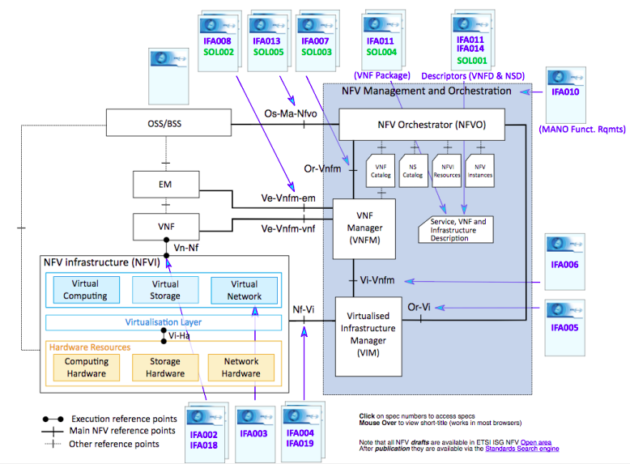
RunTime Component - VFC (Virtual Function Controller)
• Provides reference implementation of NFVO in ETSI MANO architecture
• Provides Network service life cycle management
• Provides NS/VNF layer’s FCAPS management

Slide 38
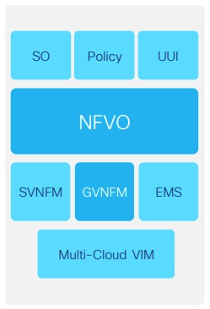
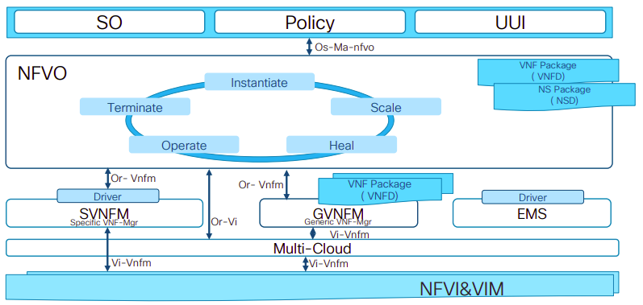
VFC Components
GVNFM Functions
•VNF Lifecycle Management, including VNF deploy, scale, heal, operate (start/stop/ restart/…), update and terminate, etc
• Support multiple VNFs and multi-type VNFs from different vendors
• Support multiple VIM environments and multi-type VM environments based on VM or Docker
NFVO Functions
• NS Lifecycle Management including NS instantiate, scale, heal, operate (query /update/…)and terminate. Most of NSLCM interfaces align with SOL005 Os-Ma-nfvo reference point
• Integration with multi VNFMs via drivers which include vendors VNFM and generic VNFM. The interfaces between NFVO and driver comply with Or-Vnfm reference point.
• Support integration with multi VIM via Multi-Cloud
• NFVO also supports integration with vendor EMS via driver

Slide 39
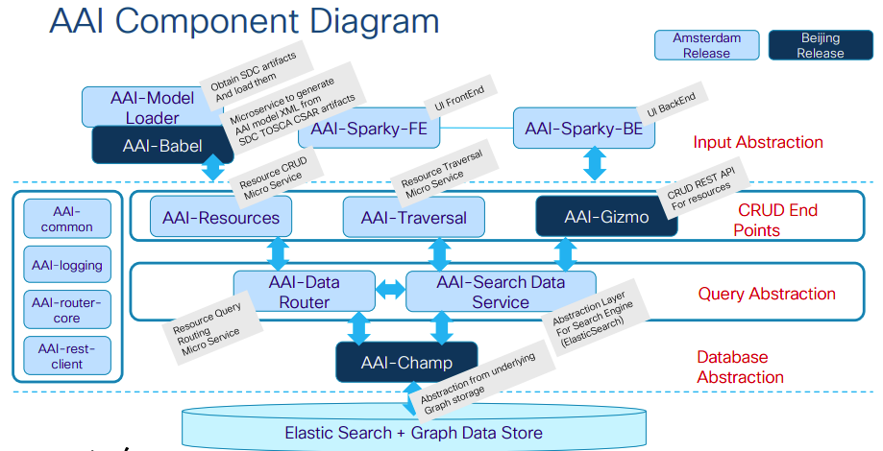
RunTime Component - Active and Available Inventory (AAI)
• Central ONAP Registry:
• Maintain a live view of services and resources in the network, providing the state and relationships of the service components
• Maintain the view of the managed systems services and resources, as well as information of the external systems that ONAP will connect to.
• Provide real-time views of a managed systems resources, services and relationships with each other.
• Access via REST API and GUI

Slide 40
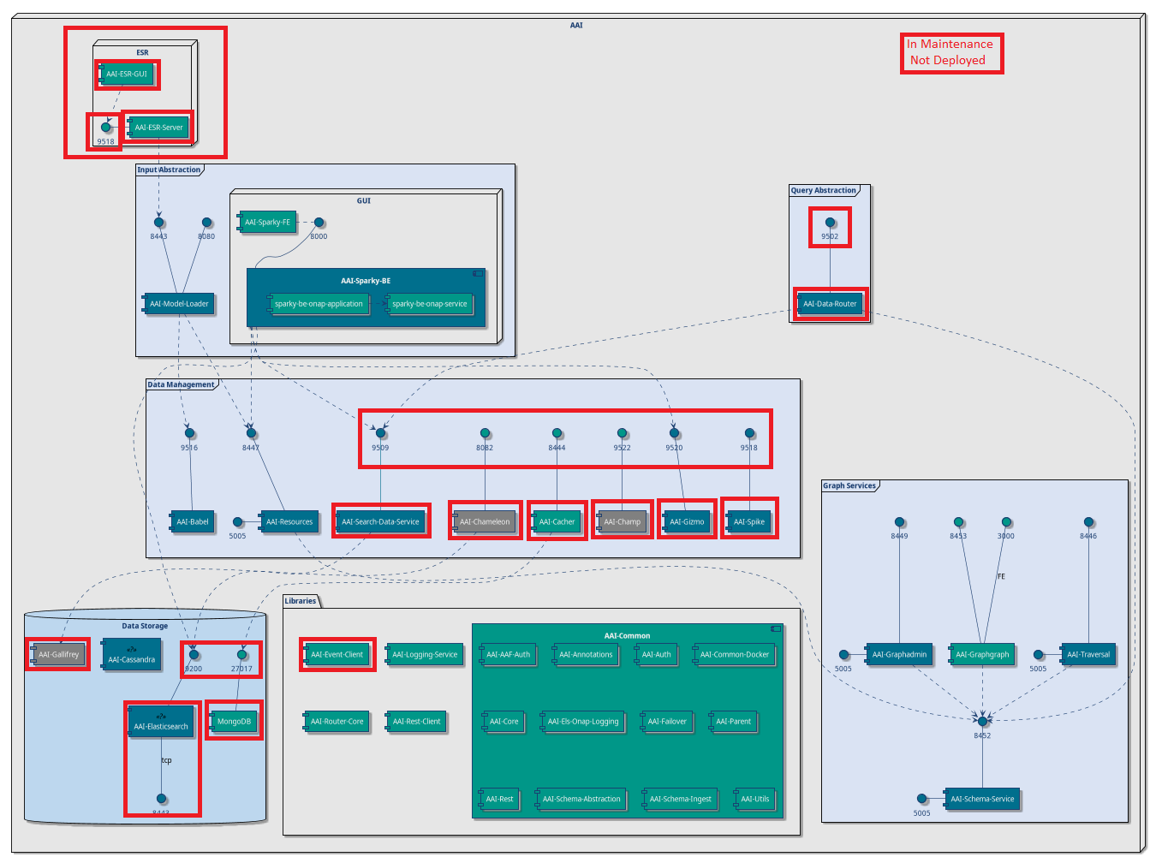
RunTime Component - Active and Available Inventory (AAI)
CRUD Microservices
Resources
Traversal
Graphadmin
Schema Service
User Interface
Sparky (AAIUI)
Search Data Service
Data Router
Elasticsearch
TOSCA Processing
Model Loader
Babel

Slide 41
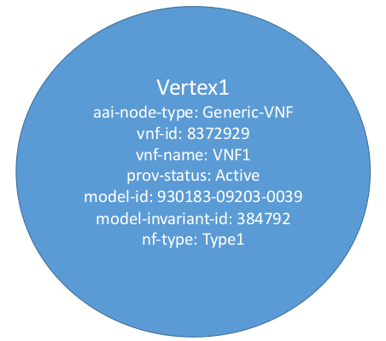
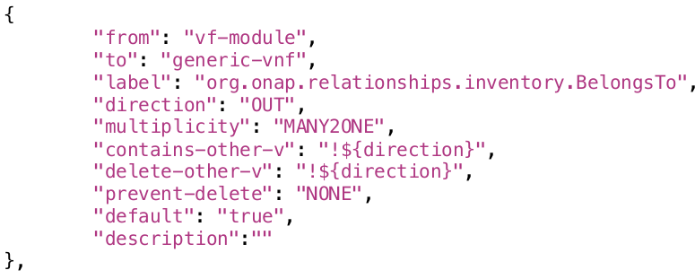
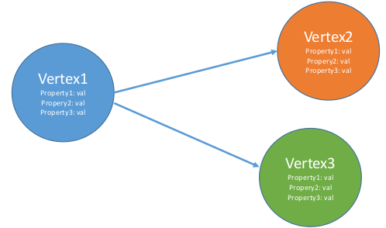
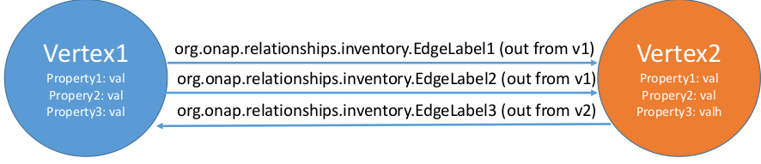
AAI Graph Basics
A&AI uses Janusgraph for persistence which is a property graph
model, where a graph is a set of vertices with edges between them.
• JanusGraph stores graphs in adjacency list format which means that a
graph is stored as a collection of vertices with their adjacency list.
The adjacency list of a vertex contains all of the vertex’s incident edges (and properties).
A vertex is the fundamental unit of the graph and represents an object.
Vertex can have properties to describe the object.
An edge is a connection between two vertices that expresses a relationship
between them. An edge can have a multiplicity, direction,and properties.

Slide 42
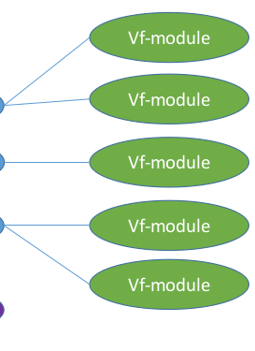
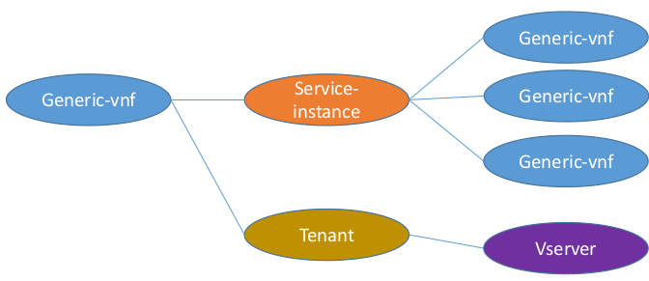
AAI Graph Basics
• Traversal Example: A custom query that starts at a generic-vnf, follows the edge to the service-instance, then gets all connected vnfs and their vf-modules
• Also fetches the related tenant and vserver

Slide 43
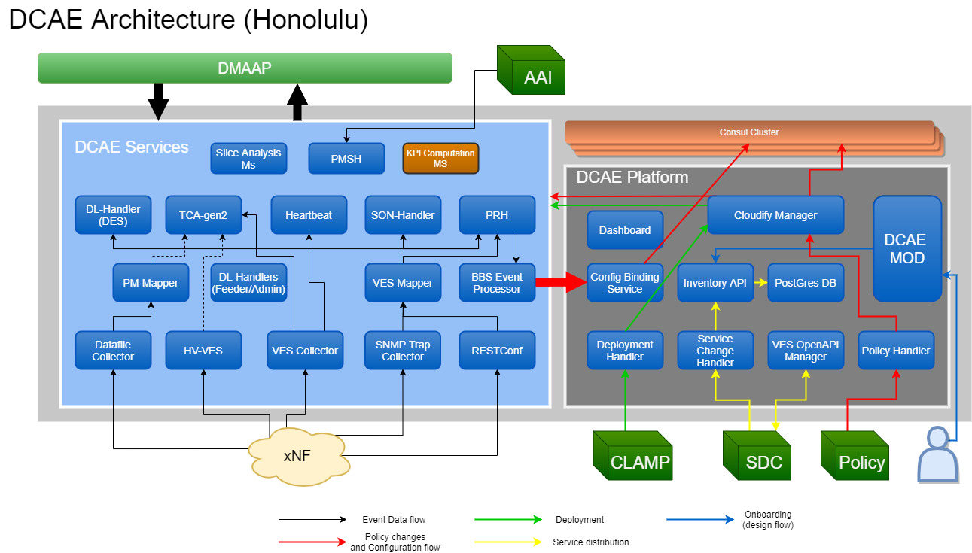
ClosedLoop Component - ONAP Data Collection, Analytics, Events (DCAE)
DCAE gathers performance, usage, and configuration data from the managed environment. Data is then fed to various analytic applications, and if anomalies or significant events are detected, the results trigger appropriate actions, such as publishing to other ONAP components such as Policy, SO, or Controllers.
Collect, ingest, transform and store data as necessary for analysis
Provide a framework for development of analytics

Slide 44
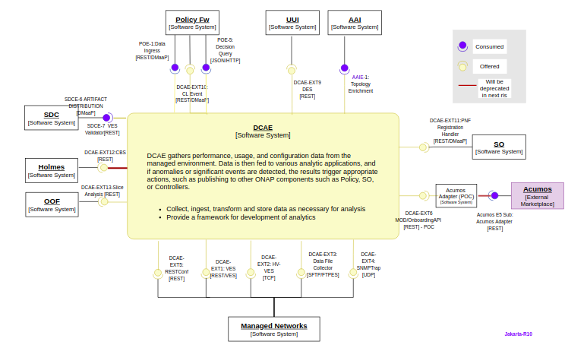
ClosedLoop Component - ONAP Data Collection, Analytics, Events (DCAE)

Slide 45
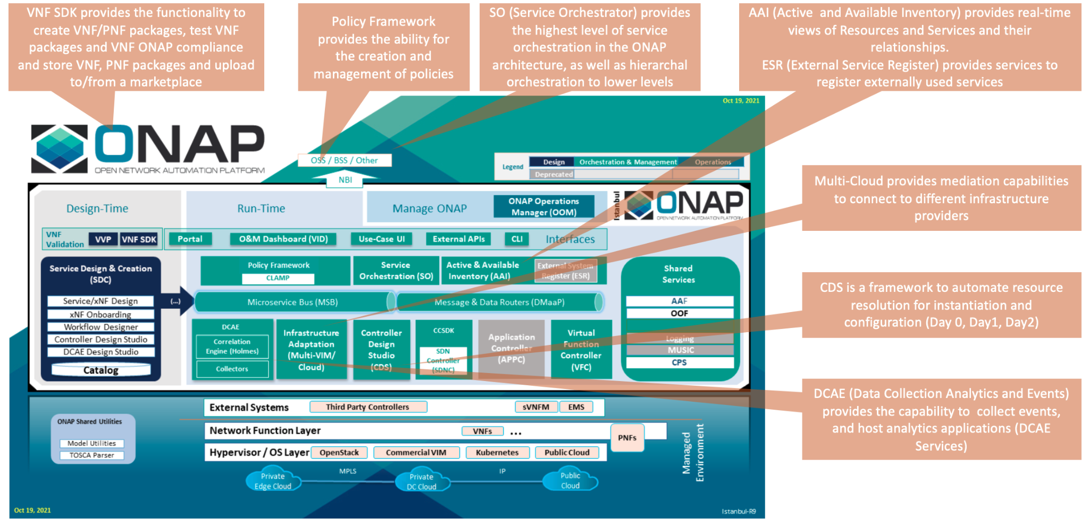
ONAP Architecture

Slide 46
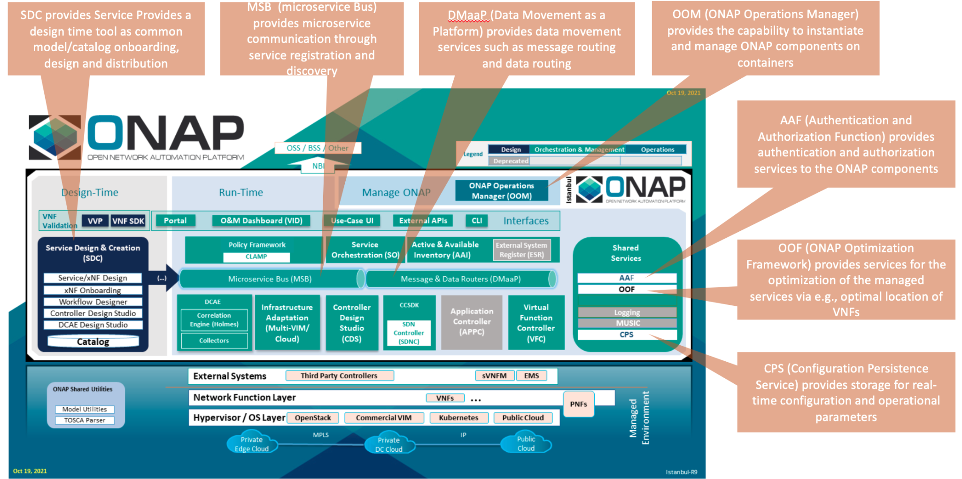
ONAP Architecture

Slide 47
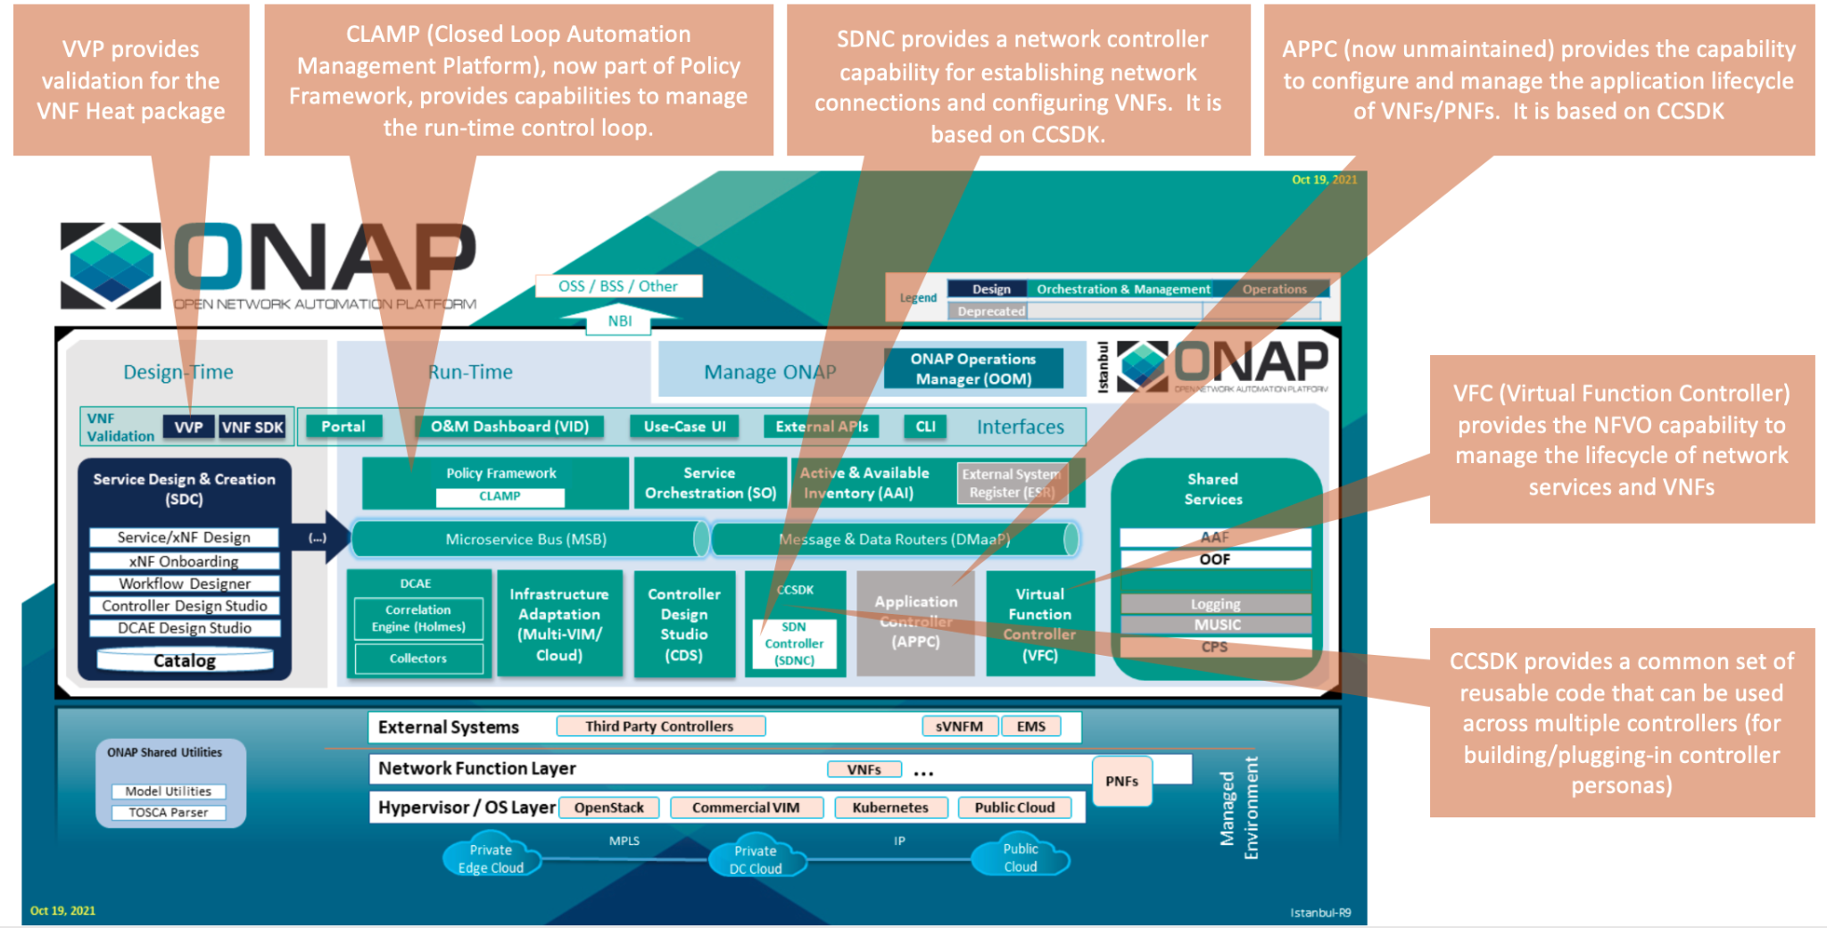
ONAP Architecture

Slide 48

ONAP Architecture

Slide 49


Use-cases
Cross Domain and Cross Layer VPN (CCVPN) Blueprint
The CCVPN (Cross Domain and Cross Layer VPN) blueprint is a combination of SOTN (Super high-speed Optical Transport Network) and ONAP, which takes advantage of the orchestration ability of ONAP, to realize a unified management and scheduling of resources and services. It achieves cross-domain orchestration and ONAP peering across service providers. In this blueprint, SO is responsible for CCVPN end-to-end service orchestration working in collaboration with VF-C and SDN-C. SDN-C establishes network connectivity completes the Network Services and VNF lifecycle management. ONAP peering across CSPs uses an east-west API which is being aligned with the MEF Interlude API. The key innovations in this use case are physical network discovery and modeling, cross-domain orchestration across multiple physical networks, cross operator end-to-end service provisioning, close-loop reroute for cross-domain service, dynamic changes (branch sites, VNFs) and intelligent service optimization (including AI/ML). The Frankfurt release adds support for end-to-end E-LINE services over optical transport network (OTN) network-to-network interface (NNI).
Multi-Domain Optical Network Service (MDONS) Blueprint
While CCVPN addresses the automation of networking layers 2 and 3, it does not address layers 0 and 1. Automating these layers is equally important because providing an end-to-end service to their customers often requires a manual and complex negotiation between CSPs that includes both the business arrangement and the actual service design and activation. CSPs may also be structured such that they operate multiple networks independently and require similar transactions among their own networks and business units in order to provide an end-to-end service. The MDONS blueprint created by AT&T, Orange, and Fujitsu solves the above problem. MDONS and CCVPN used together can solve the OTN automation problem in a comprehensive manner.
https://www.onap.org/architecture/use-cases-blue-prints#:~:text=ONAP%20supports%20the%20VoLTE%20use,%2DC%20and%20SDN%2DC.

Slide 50

Use-cases
5G Blueprint
The 5G blueprint is a multi-release effort, with five key initiatives around end-to-end service orchestration, network slicing, PNF/VNF lifecycle management , PNF integration, and network optimization. The combination of eMBB that promises peak data rates of 20 Mbps, uRLLC that guarantees sub-millisecond response times, MMTC that can support 0.92 devices per sq. ft., and network slicing brings with it some unique requirements.
First ONAP needs to manage the lifecycle of a network slice from initial creation/activation all the way to deactivation/termination.
Next, ONAP needs to optimize the network around real time and bulk analytics, place VNFs on the correct edge cloud, scale and heal services, and provide edge automation. ONAP also provides self organizing network (SON) services such as physical cell ID allocation for new RAN sites. These requirements have led to the five above-listed initiatives and have been developed in close cooperation with other standards and open source organizations such as 3GPP, TM Forum, ETSI, and O-RAN Software Community. See the 5G E2E Network Slicing Technical Overview Document.

Slide 51


Use-cases
Broadband Service (BBS)
This blueprint provides multi-gigabit residential internet connectivity services based on PON (Passive Optical Network) access technology. A key element of this blueprint is to show automatic re-registration of an ONT (Optical Network Terminal) once the subscriber moves (nomadic ONT) as well as service subscription plan changes. This blueprint uses ONAP for the design, deployment, lifecycle management, and service assurance of broadband services. It further shows how ONAP can orchestrate services across different locations (e.g. Central Office, Core) and technology domains (e.g. Access, Edge).
Voice over LTE (VoLTE) Blueprint
This blueprint uses ONAP to orchestrate a Voice over LTE service. The VoLTE blueprint incorporates commercial VNFs to create and manage the underlying vEPC and vIMS services by interworking with vendor-specific components, including VNFMs, EMSs, VIMs and SDN controllers, across Edge Data Centers and a Core Data Center. ONAP supports the VoLTE use case with several key components: SO, VF-C, SDN-C, and Multi-VIM/ Cloud. In this blueprint, SO is responsible for VoLTE end-to-end service orchestration working in collaboration with VF-C and SDN-C. SDN-C establishes network connectivity, then the VF-C component completes the Network Services and VNF lifecycle management (including service initiation, termination and manual scaling) and FCAPS (fault, configuration, accounting, performance, security) management. This blueprint also shows advanced functionality such as scaling and change management.
https://www.onap.org/architecture/use-cases-blue-prints

Slide 52

ONAP Getting Involved

Slide 53
References
Read the docs:
https://docs.onap.org/en/latest/
https://docs.onap.org/en/latest/guides/overview/index.html#overview
https://docs.onap.org/en/latest/guides/onap-developer/architecture/onap-architecture.html#onap-architecture
ONAP Wiki link:
https://wiki.onap.org/
https://wiki.onap.org/display/DW/All+Approved+Projects
Code Links:
https://gerrit.onap.org/
https://github.com/onap
ONAP devops:
https://jenkins.onap.org/
https://sonarcloud.io/organizations/onap/projects

Slide 54
Thank you…

Slide 55
BackUp slides

Slide 56


NFV Orchestration vs. Service Orchestration
Many organizations have augmented the NFV architecture with a Service Orchestration function that is aware of the network service semantics, and coordinates all management actions, including PNF/VNF/CNF application configuration.
NFV Network Service (NS) Orchestration (as performed by the NFVO) should not be confused with such type of Service Orchestration.
Disclaimer: This type of Service Orchestration is not currently addressed by ETSI NFV and falls in the OSS functional block of the NFV Architectural Framework

Slide 57

ONAP SO NFVO Default Workflows

Slide 58
ONAP SO Hierarchical ETSI-based Orchestration
• The diagram depicts the orchestration
functional blocks
• It is an ETSI-based hierarchical orchestration concept, to facilitate ONAP orchestration adoption by operators who have their own NFVOs and/or VNFMs
- E2E, NS, VNF, CNF orchestration
by leveraging ETSI standards
• Working with the existing VFC and external NFVOs
• Leveraging the common ETSI Catalog Manager
• Leveraging the common OOF for homing
• Possible ONAP SO embedded NFVO block
- Handle NS LCM Orchestration
- Take over Granting and Package
Management from the SOL003 Adapter
- Support SOL005 Northbound Interface
- Support Or-Vi Indirect Resource control for VIM
- Possibly, interface with other peer
NFVOs (Or-Or)
SOL002 Adapter deployment location will be decided.

Slide 59

ONAP SO NFVO Invocation Sequence
https://wiki.onap.org/pages/viewpage.action?pageId=84670309

Slide 61
What are the Benefits of Network Automation
Eliminate manual tasks. Automating your network replaces manual tasks with predictable, repeatable network changes. That raises IT productivity, since you’re able to focus on strategic opportunities that drive business growth.
Accelerate service delivery. A critical benefit: provide key data services faster, optimize network performance, and speed rollout of new services and applications.
Standardize processes with templates. Leverage standardized templates to drive efficiency among network stakeholders and streamline network changes.
Make changes faster. More frequently execute network changes that previously you rarely performed because they were manual, time consuming, and resource intensive.
Build a reliable network. Utilize an infrastructure-as-code approach to maintain the state and configuration of your network – from data center to edge – in much the same way that developers manage source code.
Gain network visibility. Access wide-ranging performance monitoring capabilities to pinpoint performance issues, spiking resource utilization levels, and errors on the network.
Analyze and resolve issues. Rely on network analytics for insight into performance, utilization, security, and resource allocation that help resolve issues far faster than via manual techniques.

Slide 62
Organizations Benefits for automating their networks and services
Reduction in number of issues — By leveraging low-code and playbook powered workflows, and with the efficiency of closed-loop, intent based operations, common network issues are resolved spontaneously. The potential for manual process-related errors like configuration errors, typos and more are reduced.
Lower costs — Because automation reduces the complexities of your underlying infrastructure, dramatically fewer person-hours are required for configuring, provisioning, and managing services and the network. By simplifying operations, consolidating network services, reducing floor space, and cycling underutilized devices off, you need fewer staff to troubleshoot and repair, and reap power savings.
Increased Network Resiliency — By removing the need for manual interruption in case of an event, companies can offer and deliver a higher level of services with more consistency across branches and geographies.
Reduction in Network Downtime — By removing the chance for human errors, companies can offer and deliver a higher level of services with more consistency across branches and geographies. For example, Juniper Networks’ Service Now is a remote, automated troubleshooting client that enables Juniper to detect quickly and proactively any problems in a customer’s network before they become aware of them.
Increase strategic workforce — By automating repetitive tasks subject to human error, companies increase productivity, which helps drive business improvements and innovation. As a result, new job opportunities arise for the existing workforce.
Greater insight and network control — Automation helps make IT operations more responsive to change through analytics. You gain more visibility into the network and understand precisely what is happening in your network with the ability to control and adapt as needed.

Slide 63
Network Automation
Today, network automation solutions can undertake a broad array of tasks, some of which include:
Network planning and design, including scenario planning and inventory management
Device testing and configuration verification
Provisioning of deployed physical devices and services and the deployment and provisioning of virtual devices
Collection of network data pertaining to devices, systems, software, network topology, traffic, and services in real-time
Analysis of data, including AI and ML predictive analytics, which delivers insights into current and future network behavior
Configuration compliance, which ensures that all the network devices and services are running as intended
Updating software, including rollback of software if required
Closed-loop remediation of network issues, including troubleshooting and repair of insidious gray failures
Provide insight into reports, dashboards, alerts, and alarms
Implementing security compliance
Monitoring the network and its services to ensure alignment with SLAs and customer satisfaction guarantees

Slide 64
Future of Network Automation
Networks of the future will be able to accomplish the following:
AI and ML-driven networks that can learn the intent of network behaviors, deliver predictive analysis, and provide recommendations/remediations.
Implement automatic service placement and service motion
Use advanced probing technology to actively monitor service assurance and adjust traffic flows based on service requirements
Provide specific upgrades based on configured services
Operate autonomously, with active monitoring and reporting provided to network operators to ensure that network performance and behaviors remain aligned to business goals
The route forward toward an autonomous network relies on telemetry, automation, machine learning, and programming with declarative intent. This future network is called the Self-Driving Network™, an autonomous network that is predictive and adaptive to its environment.
To be effective, automation must break free of traditional silos to address all network infrastructure elements, teams, and operations support systems.

Slide 65

VNF Instantiation

Slide 66


ETSI NFV Architecture, and NFV-MANO
Management of NFV Components

